Slide 1

ACS-441A Artificial Intelligence
Part 2: Intelligent Agents
Semester: Fall 2022.
||Fredrick Michael Ogore||fogore@daystar.ac.ke||Cell-No:0717105568||

Slide 2

Mission
To design/create computer programs that have some intelligence/ can do some intelligent tasks/ or can do tasks that require some intelligence.

Slide 3
Define Agent.
An AI system is composed of an agent and its environment. The agents act in their environment.The environment may contain other agents.
An intelligent agent (IA) is an entity that makes a decision, that enables artificial intelligence to be put into action.
It can also be described as a software entity that conducts operations in the place of users or programs after sensing the environment.
It uses actuators to initiate action in that environment.

Slide 4
Define Agent.
It’s also termed as ‘intelligent’ because of its ability to learn during the process of performing tasks.
Intelligent agents consist of sub-agents that form a hierarchical structure.
Lower-level tasks are performed by these sub-agents.
The higher-level agents and lower-level agents form a complete system that can solve difficult problems through intelligent behaviors or responses.

Slide 5
What is an (Intelligent) Agent?
An over-used, over-loaded, and misused term.
Anything that can be viewed as perceiving its environment through sensors and acting upon that environment through its effectors to maximize progress towards its goals.
PAGE (Percepts, Actions, Goals, Environment)
Task-specific & specialized: well-defined goals and environment
The notion of an agent is meant to be a tool for analyzing systems, not an absolute characterization that divides the world into agents and non-agents.

Slide 6
What are Agent and Environment?
An agent is anything that can perceive its environment through sensors and acts upon that environment through effectors.
  A human agent has sensory organs such as eyes, ears, nose, tongue and skin parallel to the sensors, and other organs such as hands, legs, mouth, for effectors.
  A robotic agent replaces cameras and infrared range finders for the sensors, and various motors and actuators for effectors.
  A software agent has encoded bit strings as its programs and actions.

Slide 7
Agent Terminology
Performance Measure of Agent − It is the criteria, which determines how successful an agent is.
Behavior of Agent − It is the action that agent performs after any given sequence of percepts.
Percept − It is agent’s perceptual inputs at a given instance.
Percept Sequence − It is the history of all that an agent has perceived till date.
Agent Function − It is a map from the precept sequence to an action.

Slide 8
Agent Terminology
Performance Measure of Agent − It is the criteria, which determines how successful an agent is.
Behavior of Agent − It is the action that agent performs after any given sequence of percepts.
Percept − It is agent’s perceptual inputs at a given instance.
Percept Sequence − It is the history of all that an agent has perceived till date.
Agent Function − It is a map from the precept sequence to an action.

Slide 9
Rationality
Rationality is nothing but status of being reasonable, sensible, and having good sense of judgment.
Rationality is concerned with expected actions and results depending upon what the agent has perceived.
Performing actions with the aim of obtaining useful information is an important part of rationality.

Slide 10
Rationality of an Agent?
Rationality of an agent depends on the following −
The performance measures, which determine the degree of success.
Agent’s Percept Sequence till now.
The agent’s prior knowledge about the environment.
The actions that the agent can carry out.

Slide 11
The Structure of Intelligent Agents
Agent’s structure can be viewed as −
Agent = Architecture + Agent Program
Architecture = the machinery that an agent executes on.
Agent Program = an implementation of an agent function.

Slide 12
The Structure of Intelligent Agents
Agent’s structure can be viewed as −
  Agent = Architecture + Agent Program
  Architecture = the machinery that an agent executes on.
  Agent Program = an implementation of an agent function.

Slide 13
The Functions of an Artificial Intelligence Agent
Artificial Intelligence agents perform these functions continuously:
  Perceiving dynamic conditions in the environment
  Acting to affect conditions in the environment
  Using reasoning to interpret perceptions
  Problem-solving
  Drawing inferences
  Determining actions and their outcomes

Slide 14
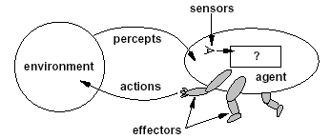
Intelligent Agents
Agents interact with environments through sensors and effectors

Slide 15

Intelligent Agents and Artificial Intelligence
Human mind as network of thousands or millions of agents all working in parallel. To produce real artificial intelligence, this school holds, we should build computer systems that also contain many agents and systems for arbitrating among the agents' competing results.
Distributed decision-making
and control
Challenges:
  Action selection: What next action
  to choose
  Conflict resolution
Agency
sensors
effectors

Slide 16
Agent Research Areas
We can split agent research into two main strands:
Distributed Artificial Intelligence (DAI) –
Multi-Agent Systems (MAS) (1980 – 1990)
Much broader notion of "agent" (1990’s – present)
  interface, reactive, mobile, information

Slide 17
A Windscreen Agent
How do we design a agent that can wipe the windscreens when needed?
Goals?
Percepts ?
Sensors?
Effectors ?
Actions ?
Environment ?

Slide 18
A Windshield Wiper Agent (Cont’d)
Goals: To keep windscreens clean and maintain good visibility
Percepts: Raining, Dirty, Clear
Sensors: Camera (moist sensor)
Effectors: Wipers (left, right, back)
Actions: Off, Slow, Medium, Fast
Environment: Nairobi city, pot-holed roads, highways, bundus, weather …

Slide 19

Towards Autonomous Vehicles

Slide 20
Interacting Agents
Collision Avoidance Agent (CAA)
Goals: Avoid running into obstacles
Percepts ?
Sensors?
Effectors ?
Actions ?
Environment: Highway
Lane Keeping Agent (LKA)
Goals: Stay in current lane
Percepts ?
Sensors?
Effectors ?
Actions ?
Environment: Freeway

Slide 21
Interacting Agents
Collision Avoidance Agent (CAA)
Goals: Avoid running into obstacles
Percepts: Obstacle distance, velocity, trajectory
Sensors: Vision, proximity sensing
Effectors: Steering Wheel, Accelerator, Brakes, Horn, Headlights
Actions: Steer, speed up, brake, blow horn, signal (headlights)
Environment: Highway
Lane Keeping Agent (LKA)
Goals: Stay in current lane
Percepts: Lane center, lane boundaries
Sensors: Vision
Effectors: Steering Wheel, Accelerator, Brakes
Actions: Steer, speed up, brake
Environment: Freeway

Slide 22
The Right Thing = The Rational Action
Rational Action: The action that maximizes the expected value of the performance measure given the percept sequence to date
  Rational = Best ?
  Rational = Optimal ?
  Rational = Omniscience ?
  Rational = Successful ?

Slide 23
The Right Thing = The Rational Action
Rational Action: The action that maximizes the expected value of the performance measure given the percept sequence to date
  Rational = Best Yes, to the best of its knowledge
  Rational = Optimal Yes, to the best of its abilities (incl. its constraints)
  Rational ≠ Omniscience
  Rational ≠ Successful

Slide 24
Behavior and performance of IAs
Perception (sequence) to Action Mapping: f : P* → A
  Ideal mapping: specifies which actions an agent ought to take at any point in time
  Description: Look-Up-Table,..
Performance measure: a subjective measure to characterize how successful an agent is (e.g., speed, power usage, accuracy, money, etc.)
(degree of) Autonomy: to what extent is the agent able to make decisions and actions on its own?

Slide 25
How is an Agent different from other software?
Agents are autonomous, that is they act on behalf of the user
Agents contain some level of intelligence, from fixed rules to learning engines that allow them to adapt to changes in the environment
Agents don't only act reactively, but sometimes also proactively
Agents have social ability, that is they communicate with the user, the system, and other agents as required
Agents may also cooperate with other agents to carry out more complex tasks than they themselves can handle
Agents may migrate from one system to another to access remote resources or even to meet other agents

Slide 26
How to Improve the Performance of Intelligent Agents?
When tackling the issue of how to improve intelligent Agent performances, all we need to do is ask ourselves, “How do we improve our performance in a task?”
The answer, of course, is simple. We perform the task, remember the results, then adjust based on our recollection of previous attempts.
Artificial Intelligence Agents improve in the same way.
The Agent gets better by saving its previous attempts and states, learning how to respond better next time.
This place is where Machine Learning and Artificial Intelligence meet.

Slide 27
Environment Types
Characteristics
  Accessible vs. inaccessible (Fully vs. Partially observable)
    An environment is accessible if the sensors detect all aspects that are relevant to the choice of action.
  Deterministic vs. non-deterministic/Stochastic
    If the next state of the environment is completely determined by the current state and the actions selected by the agents, then we say the environment is deterministic.
  Episodic vs. non-episodic/Sequential
    In an episodic environment, the agent’s experience is divided into “episodes.” Each episode consists of the agent perceiving and then acting.
  Static vs. dynamic
    If the environment can change while an agent is deliberating, then we say the environment is dynamic for that agent; otherwise it is static.

Slide 28
Environment Types
Characteristics
  Discrete vs. continuous
    If there are a limited number of distinct, clearly defined percepts and actions we say that the environment is discrete.
  Hostile vs. friendly
    This depends on the agent perception.
  Single agent vs. Multi-agent
    Single agent solves a problem by itself eg agent solving a crossword puzzle
    Multi-agent works in existence of other agents eg chess is competitive multi-agent environment since it maximizes its performance and minimizes the performance of opponent but avoiding collisions maximizes performances of all agents hence co-operative

Slide 29
Environment types
Environment
Accessible
Deterministic
Episodic
Static
Discrete
Operating System
Virtual Reality
Office Environment
Mars

Slide 30
Environment types
Environment
Accessible
Deterministic
Episodic
Static
Discrete
Operating System
Yes
Yes
No
No
Yes
Virtual Reality
Yes
Yes
Yes/No
No
Yes/No
Office Environment
No
No
No
No
No
Mars
No
Semi
No
Semi
No
The environment types largely determine the agent design.
Some agents are more complex to design depending on environment
The more difficult an environment the more complex the agent design

Slide 31
Agent types
Agents can be grouped into four classes based on their degree of perceived intelligence and capability :
Simple Reflex Agents
Model-Based Reflex Agents
Goal-Based Agents
Utility-Based Agents
Learning Agent

Slide 32
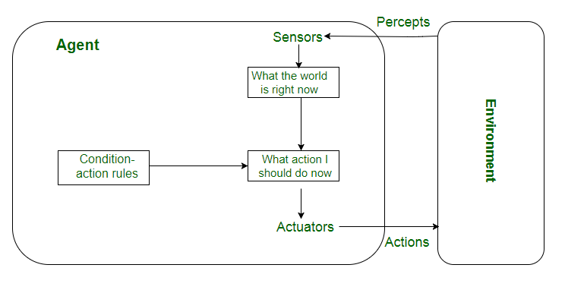
Reflex agents

Slide 33
Simple reflex agents
Simple reflex agents ignore the rest of the percept history and act only on the basis of the current percept.
Percept history is the history of all that an agent has perceived till date.
The agent function is based on the condition-action rule.
A condition-action rule is a rule that maps a state i.e, condition to an action. If the condition is true, then the action is taken, else not.
This agent function only succeeds when the environment is fully observable.

Slide 34
Simple reflex agents
For simple reflex agents operating in partially observable environments, infinite loops are often unavoidable.
It may be possible to escape from infinite loops if the agent can randomize its actions.
Problems with Simple reflex agents are :
  Very limited intelligence.
  No knowledge of non-perceptual parts of state.
  Usually too big to generate and store.
  If there occurs any change in the environment, then the collection of rules need to be updated

Slide 35
Model-based reflex agents
These kind of agents take decision based on how far they are currently from their goal(description of desirable situations).
Their every action is intended to reduce its distance from the goal.
This allows the agent a way to choose among multiple possibilities, selecting the one which reaches a goal state. The knowledge that supports its decisions is represented explicitly and can be modified, which makes these agents more flexible. They usually require search and planning.
The goal-based agent’s behavior can easily be changed.

Slide 36
GOAL-based Agents
These kind of agents take decision based on how far they are currently from their goal(description of desirable situations).
Their every action is intended to reduce its distance from the goal.
This allows the agent a way to choose among multiple possibilities, selecting the one which reaches a goal state.
The knowledge that supports its decisions is represented explicitly and can be modified, which makes these agents more flexible. They usually require search and planning.
The goal-based agent’s behavior can easily be changed.

Slide 37
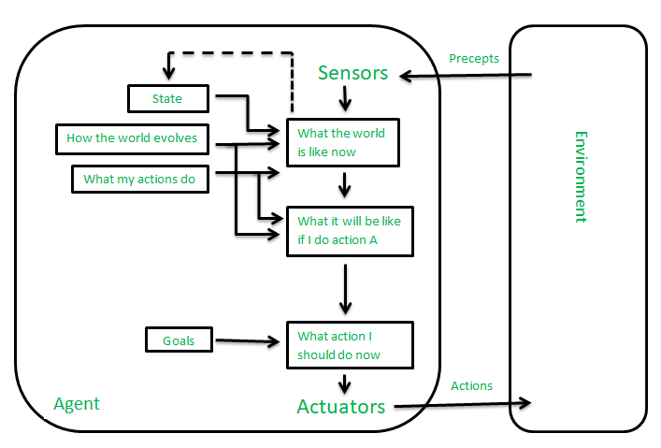
GOAL-based Agents

Slide 38
Utility-based agents
The agents which are developed having their end uses as building blocks are called utility based agents.
When there are multiple possible alternatives, then to decide which one is best, utility-based agents are used.They choose actions based on a preference (utility) for each state.
Sometimes achieving the desired goal is not enough. We may look for a quicker, safer, cheaper trip to reach a destination.
Agent happiness should be taken into consideration. Utility describes how “happy” the agent is.
Because of the uncertainty in the world, a utility agent chooses the action that maximizes the expected utility.
A utility function maps a state onto a real number which describes the associated degree of happiness.

Slide 39
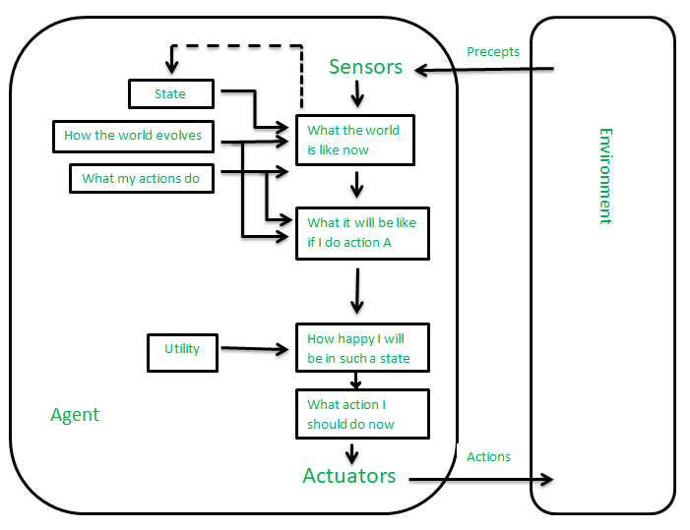
Utility-based agents

Slide 40
Learning Agent
A learning agent in AI is the type of agent which can learn from its past experiences or it has learning capabilities.
It starts to act with basic knowledge and then able to act and adapt automatically through learning.
A learning agent has mainly four conceptual components, which are:
  Learning element :It is responsible for making improvements by learning from the environment
  Critic: Learning element takes feedback from critic which describes how well the agent is doing with respect to a fixed performance standard.
  Performance element: It is responsile for selecting external action
  Problem Generator: This component is responsible for suggesting actions that will lead to new and informative experiences.
Notes:
Part2:Intelligent Agents

Slide 41
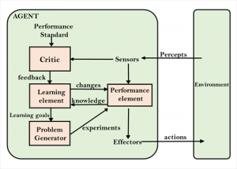
Learning Agent
Notes:
Part2:Intelligent Agents

Slide 42
Reactive agents
Reactive agents do not have internal symbolic models.
Act by stimulus-response to the current state of the environment.
Each reactive agent is simple and interacts with others in a basic way.
Complex patterns of behavior emerge from their interaction.
Benefits: robustness, fast response time
Challenges: scalability, how intelligent?
and how do you debug them?

Slide 43
Mobile agents
Programs that can migrate from one machine to another.
Execute in a platform-independent execution environment.
Require agent execution environment (places).
Mobility not necessary or sufficient condition for agenthood.
Practical but non-functional advantages:
  Reduced communication cost (e.g., from PDA)
  Asynchronous computing (when you are not connected)
Two types:
  One-hop mobile agents (migrate to one other place)
  Multi-hop mobile agents (roam the network from place to place)
Applications:
  Distributed information retrieval.
  Telecommunication network routing.

Slide 44
Information agents
Manage the explosive growth of information.
Manipulate or collate information from many distributed sources.
Information agents can be mobile or static.
Examples:
  BargainFinder comparison shops among Internet stores for CDs
  FIDO the Shopping Doggie (out of service)
  Internet Softbot infers which internet facilities (finger, ftp, gopher) to use and when from high-level search requests.
Challenge: ontologies for annotating Web pages (e.g., SHOE).

Slide 45
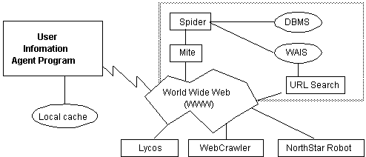

Slide 46
Structure of Intelligent Agents
Agent = architecture + program
Agent program: the implementation of f : P* → A, the agent’s perception-action mapping
function: Skeleton-Agent(Percept) returns Action
memory ← UpdateMemory(memory, Percept)
Action ← ChooseBestAction(memory)
memory ← UpdateMemory(memory, Action)
return Action
Architecture: a device that can execute the agent program (e.g., general-purpose computer, specialized device, specialized, hardware/software, etc.)

Slide 47
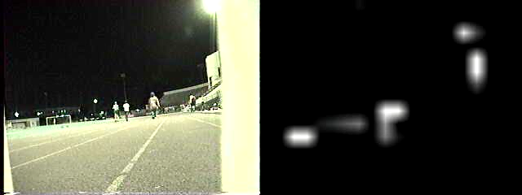
Using a look-up-table to encode f : P* → A
Example: Collision Avoidance
  Sensors: 3 proximity sensors
  Effectors: Steering Wheel, Brakes
How to generate?
How large?
How to select action?
obstacle
sensors
agent

Slide 48
Applications of intelligent agents
Information search, retrieval, and navigation
Intelligent agents enhance the access and navigation of information.
This is achieved through the search of information using search engines.
The internet consists of many data objects that may take users a lot of time to search for a specific data object.
Intelligent agents perform this task on behalf of users within a short time.
Notes:
Part2:Intelligent Agents

Slide 49
Applications of intelligent agents
Repetitive office activities
Some companies have automated certain administrative tasks to reduce operating costs.
Some of the functional areas that have been automated include customer support and sales.
Intelligent agents have also been used to enhance office productivity.
Notes:
Part2:Intelligent Agents

Slide 50
Applications of intelligent agents
Medical diagnosis
Intelligent agents have also been applied in healthcare services to improve the health of patients.
In this case, the patient is considered as the environment.
The computer keyboard is used as the sensor that receives data on the symptoms of the patient.
The intelligent agent uses this information to decide the best course of action.
Medical care is given through actuators such as tests and treatments.
Notes:
Part2:Intelligent Agents

Slide 51
Applications of intelligent agents
Vacuum cleaning
AI agents are also used to enhance efficiency and cleanness in vacuum cleaning.
In this case, the environment can be a room, table, or carpet.
Some of the sensors employed in vacuum cleaning include cameras, bump sensors, and dirt detection sensors.
Action is initiated by actuators such as brushes, wheels, and vacuum extractors.
Notes:
Part2:Intelligent Agents

Slide 52
Applications of intelligent agents
Autonomous driving
Intelligent agents enhance the operation of self-driving cars.
In autonomous driving, various sensors are employed to collect information from the environment. These include cameras, GPS, and radar.
In this application, the environment can be pedestrians, other vehicles, roads, or road signs. Various actuators are used to initiate actions.
For example, brakes are used to bring the car to a stop.
Notes:
Part2:Intelligent Agents

Slide 53
Samples AI Agents.
  https://www.youtube.com/watch?v=v6piefdXjL8
Notes:
Part2:Intelligent Agents

Slide 54
Q&A

Slide 55
Thank you.

